Slide 1
4NF – Multivalued Dependency

Slide 2
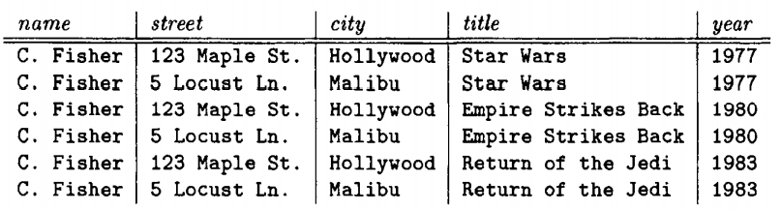
Fourth Normal Form – 4NF
Relation should be in Boyce-Codd Normal Form
It should have no multivalued dependency
BCNF?
4NF?

Slide 3
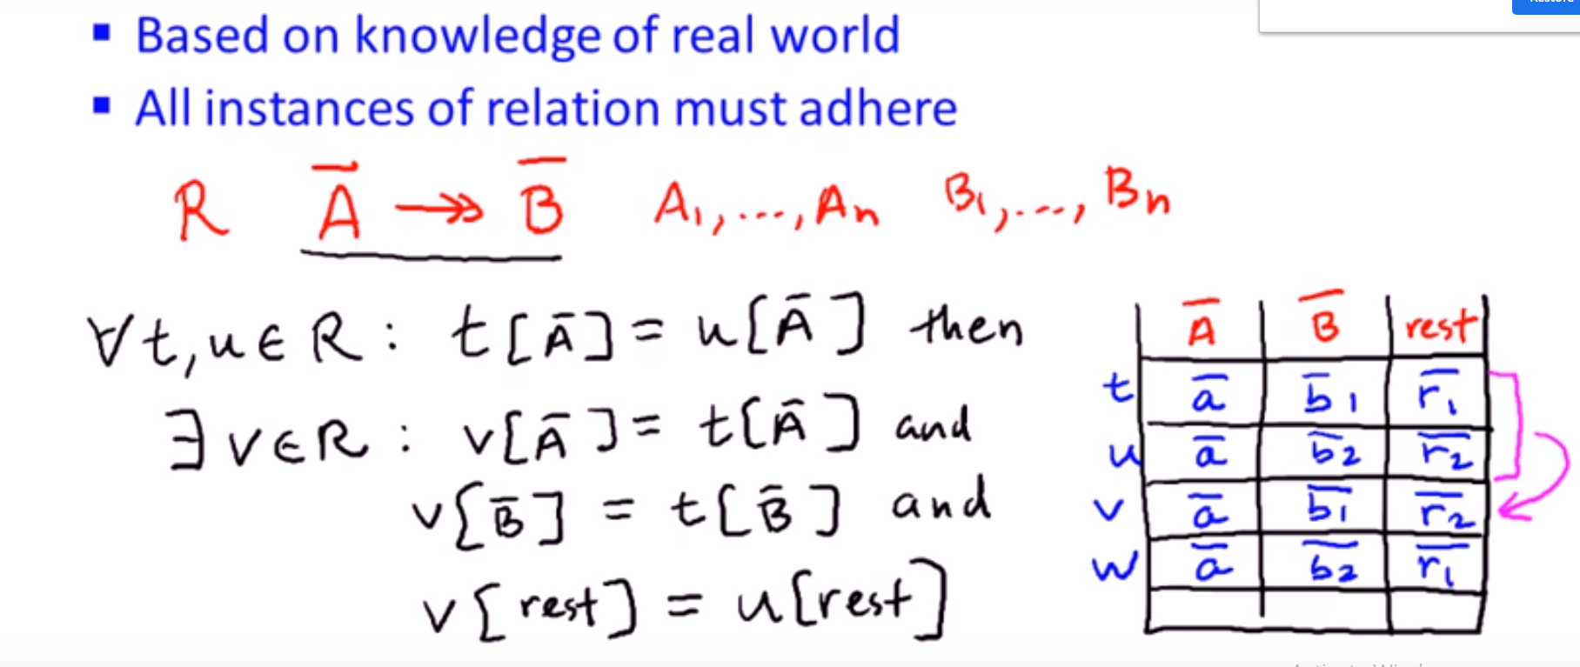
4NF – Multivalued Dependency

Slide 4
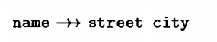

Example

Slide 5

Example

Slide 6

Example

Slide 7
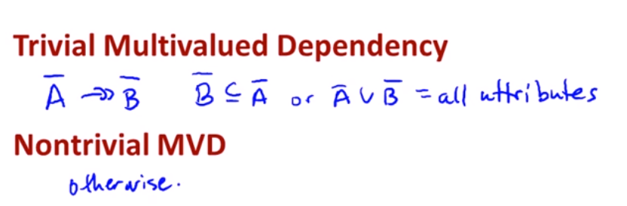
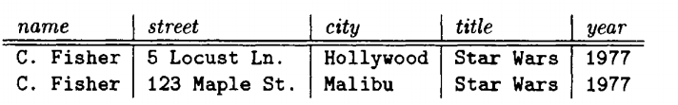
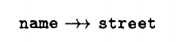
Properties
Transitive Rule:
A->>B and B->>C then A->> C
Splitting/Combining Rule:
Does not follow

Slide 8
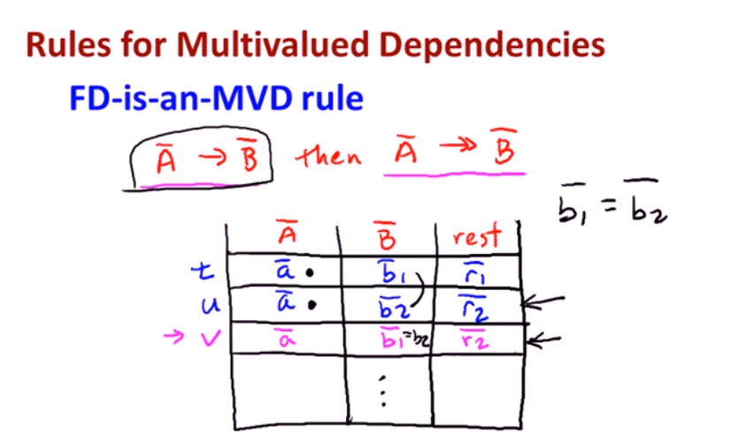
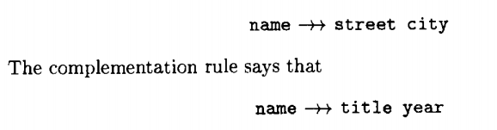
Properties
Complementation Rule:
If A->>B then A->>rest

Slide 9
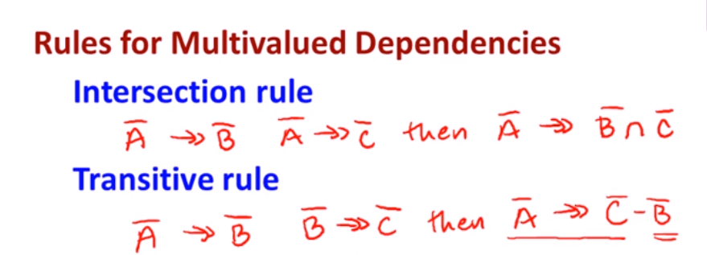

Slide 10
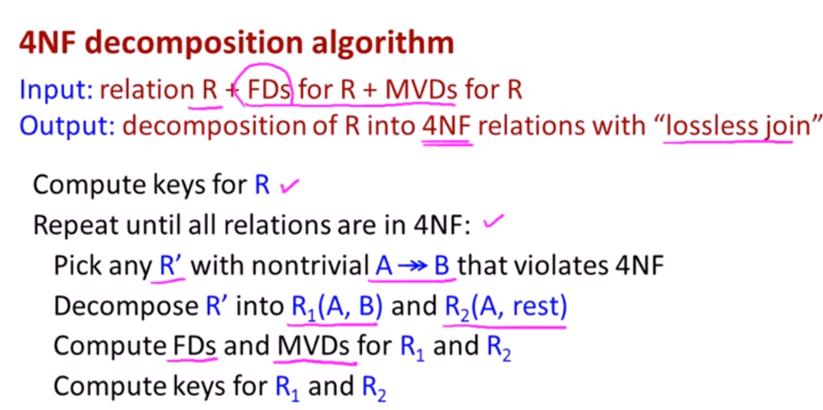

Slide 11


Slide 12
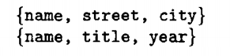
Example

Slide 13
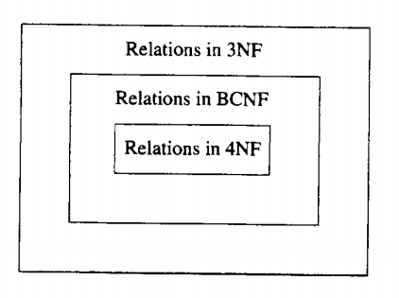
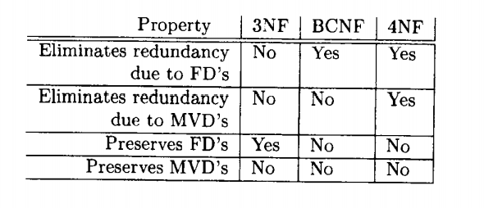
Relation among Normal Forms

